Slide 1
The American Express Innovation Labs AI Hackathon (Singapore) 2024 Modeling Problem Statement Recommendations to drive incremental activation on relevant merchants for each customer
Notes:
1

Slide 2
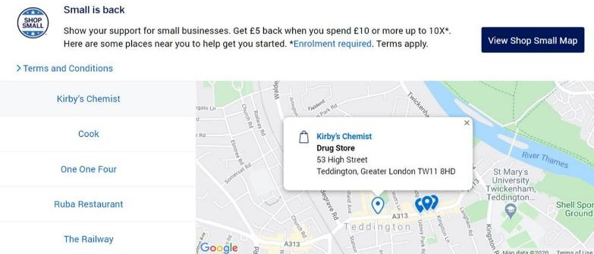


Merchant Recommender: Overview
Merchant Recommender is a capability to connect Amex Merchants (shops accepting Amex cards) & Amex Credit Card Customers
This capability recommends* personalized merchants to Credit Card Customers, to help Customers discover merchants near to them to shop, increase spend on merchants & benefit Amex enterprise by driving more revenue
Personalized Merchants for that Customer
Merchant 1
Customer visits the channel
Recommender Algorithm
Merchant 2
Merchant 1
Merchant 3
Merchant 4
Merchant 5
Sample logged in experience of Merchant recommender capability on Amex Website
*Recommendation means showing an Amex Merchant to an Amex Credit Card Customer on a marketing channel

Slide 3
Merchant Recommender: Architecture
Merchant Recommender architecture is designed as per industry best practices, and comprises of 3 modules -
Problem Statement
Candidate
Generation
Ranking
(Objective Function)
Last Mile Arbitration
Millions of
Merchants
100
Merchants
5-10
Merchants
Final
Recommendations
* Pre-select 100 nearest merchants for each customer that he/she hasn’t visited for the past three months and recommend top 10 merchants out of 100

Slide 4
Motivation
By activating ‘net-new’ merchants that the Customer would not have discovered otherwise, unless recommended
Activation Rate
Naive Response Algorithm maximizes Test Activation Rate only
Objective Function
P (Y = 1 | Recommendation)
Incremental Activation
Organic Activation
Uplift Algorithm maximizes the difference between Test & Holdout Activation Rate (or incremental activation)
Objective Function
P (Y = 1 | Recommendation) –
P (Y = 1 | no Recommendation)
#Recommendations – Unique Customer x Merchant
#Activations - First transaction (irrespective of $ amount) on Merchant within 30 days post seeing the recommendation
Activation Rate - #Activations / #Recommendations
Merchants that are activated without recommendation is organic activation

Slide 5
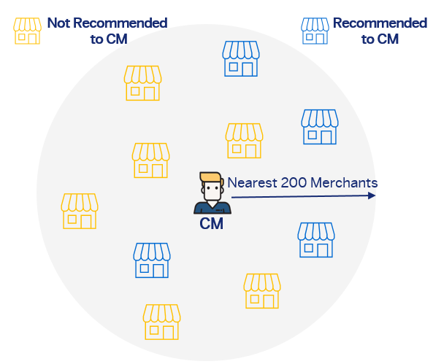
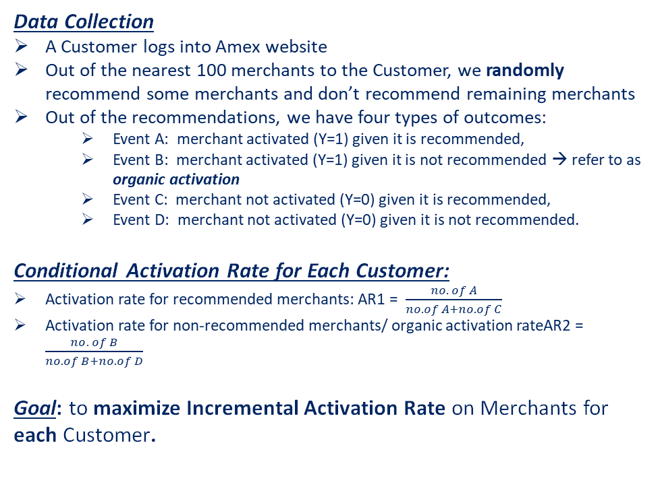
Data Collection and Objective Function
Data Collection
A Customer logs into Amex website
Out of the nearest 100 merchants to the Customer, we randomly recommend some merchants and don’t recommend remaining merchants
Out of the recommendations, we have four types of outcomes:
Event A: merchant activated (Y=1) given it is recommended,
Event B: merchant activated (Y=1) given it is not recommended → refer to as organic activation
Event C: merchant not activated (Y=0) given it is recommended,
Event D: merchant not activated (Y=0) given it is not recommended.
Conditional Activation Rate for Each Customer:
Activation rate for recommended merchants: AR1 = $\frac{no. of A}{no. of A+no. of C}$
Activation rate for non-recommended merchants/ organic activation rateAR2 = $\frac{no. of B}{no. of B+no. of D}$
Goal: to maximize Incremental Activation Rate on Merchants for each Customer.
Merchant Not Recommended
Merchant Recommended
Nearest 100 Merchants
Customer
Incremental activation rate
= P [ (Y = 1 | Recommendation) – (Y = 1 | no Recommendation)
= AR1 – AR2

Slide 6
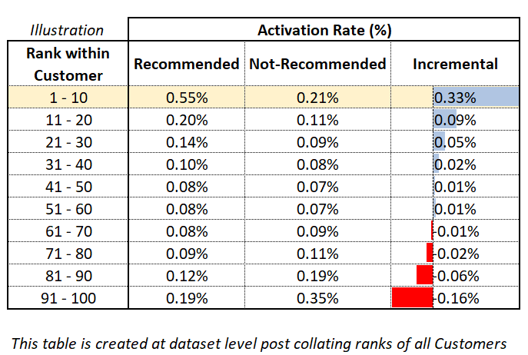
Evaluation Criteria
A good solution should be able to rank order well with Incremental Activation Rate
Steps:
Data is scored at Customer x Merchant level
Ranks are created within each Customer basis predicted score
Incremental Activation rate is calculated within the top 10 merchants (ranked by the predicted scores) for each customer
Evaluation Metric:
Incremental Activation Rate on Top 10 merchants by prediction for each Customer
*Evaluation code to be provided to participants

Slide 7
Data
Notes:
7

Slide 8
Sample of the Modeling Dataset
Illustration
Primary Key Columns
Variable Name | Description
Customer (Masked) | Masked Customer Identifier
Merchant (Masked) | Masked Merchant Identifier
ind_recommended | 1 if Merchant was recommended to Customer, 0 otherwise.
activation | 1 if Customer transacts at Merchant within 30 days post recommendation, 0 otherwise. This cannot be used as independent feature directly or indirectly.
X Features (67) | 67 Ready-to-use Independent Features are provided (details on next slide)
Customer (masked) | Merchant (masked) | ind_recommended | activation | X Features (67)
C1 | L1 | 1 | 0 | ….
C1 | L2 | 1 | 1 | ….
… | … | … | … | ….
C1 | L6 | 0 | 1 | ….
C1 | L7 | 0 | 0 | ….
… | … | … | … | ….
*ind_recommended & activation are only going to be provided for Training data

Slide 9
Details about Independent Predictors – X Features
For some of the features, raw feature descriptions have also been provided. For others, it’s same as the feature names.
None of the features have been normalized or imputed by any value
Feature Type | # Features
Numerical | 66
Categorical (Merchant_Profile_01) | 1
 | 67
Feature Category | # Features | Feature Names
Customer Digital activity | 22 | Customer_Digital_activity_1 … Customer_Digital_activity_22
Customer Spend | 14 | Customer_Spend_1 … Customer_Spend_14
Merchant Spend | 11 | Merchant_Spend_1 … Merchant_Spend_11
Distance | 5 | Distance_1 … Distance_5
Customer Industry Spend | 5 | Customer_Industry_Spend_1 … Customer_Industry_Spend_5
Customer Profile | 4 | Customer_Profile_1 … Customer_Profile_4
Customer Merchant | 3 | Customer_Merchant_1 … Customer_Merchant_3
Merchant Profile | 3 | Merchant_Profile_1 … Merchant_Profile_3
 | 67

Slide 10
Datasets
TBD
Data |  | Column Details | # Rows | # Columns | Location/Name
Train Data |  | Customer, Merchant, ind_recommended, activation + 67 X Features | 12,229,978 | 71 | To be downloaded from the unstop website (available to all registered candidates)
Round 1 Submission Data | Leaderboard Evaluation & Closed Evaluation | Customer, Merchant + 67 X Features | 12,604,600 | 69 | To be downloaded from the unstop website as a single file (available to all registered candidates)
Both datasets have been created on different time periods and are unique at Customer x Merchant level
All datasets have no overlap with respect to Customer, Merchant or Customer x Merchant
Datasets are comma-separated (,)
Please note that ind_recommended & activation columns will not be provided with Round 1 Submission data

Slide 11
Sample of a scored Round 1 submission data
Primary Key Columns
Customer (masked) | Merchant (masked) | Predicted Score
C1 | L1 | 0.5
C1 | L2 | 0.01
… | … | ….
C1 | L6 | 0.2
C1 | L7 | 0.09
… | … | ….
Predicted Score:
Score to be calculated at each row i.e., unique combination of Customer x Merchant
This predicted score will be used for evaluation
Scored submission data unique Customer x Merchant counts should match with Submission Data Round 1 counts mentioned in previous slide

Slide 12
Stages of Competition
Round 1 Submission
(live leaderboard based on leaderboard evaluation)
End of Round 1
(Final leaderboard rank based on leaderboard and closed evaluations)
Final Round
(Code/Deck Submission & Presentation)

Slide 13
Round 1 Guidelines
Participants will train their model using labeled Training Data
They are free to split the training data into Train & Out-of-sample/In-time data into whatever ratio they deem fit. They are also free to use any sampling technique on Train data*
An evaluation custom code (in python) to calculate “Incremental Activation Rate (at dataset level) on Top 10 merchants (by prediction) for each Customer” would be provided to participants to run on their training/out-of-sample data scores to mimic the exact evaluation process that will run on their submitted Round 1 data. Directions to run the code have been mentioned in the beginning of the code. This code cannot be used on scored Round 1 submission data as it doesn’t have the ‘activation’ column.
Once they have the best model according to them, they can score the Round 1 submission data and upload it
Scored Round 1 submission data should be a csv & delimited by “,”. The first row should be the header with column names: customer, merchant & predicted_score. None of these 3 columns can be missing/null/na etc.
Scored Round 1 submission data should have only 3 columns and unique Customer x Merchant count should be 12,604,600
Top 15 Teams with Highest “Incremental Activation Rate on Top 10 merchants by prediction for each Customer (Leaderboard + Closed evaluation datasets)” will be shortlisted for Round 2
*Train data has already been sampled once before sharing, hence will contain < 100 merchants per Customer

Slide 14
Round 2 Guidelines
Top 15 teams from Round 1 will be asked to upload
Code used for the task
Deck to communicate details of the approach to arrive at the final solution
The deck should detail their approach including (but not limited to) sampling technique, Feature Engineering/Selection, Algorithm/Modelling Framework used and Model Intuition.
Teams participating in this round may be given an interview opportunity to work/intern at AMEX Singapore
Finally, the Top 5 teams with the best code and deck will be shortlisted and invited for the final round

Slide 15

Final Round Guidelines
Top 5 teams from Round 2 will be invited to the American Express Singapore office (One Marina Boulevard) to present their work to a panel of judges
Performance in this round will determine the placement of the top 3
DISCLAIMER:
Please note that some forms of recordings may take place during the event, including photography, video and/or audio recordings. By attending the event, you will hereby give your consent for your image or voice (‘data’) to be recorded at the event and for such data to be used or quoted in internal printed materials at American Express and/or external media channels (including social media sites).

Slide 16
All the Best!!!

